Slide 1
Promotion & dig deeper

Slide 2
Being president of your own career
A word game &
A mind game
For some, a game changer

Slide 3
2 Pillars
Noble Selfishness
Confident Humility

Slide 4
Employee vs. President mindset
Control
Time perspective
Beholden to …
Scope
The amazing shift from the “just-a-downsized-project-manager” mindset

Slide 5
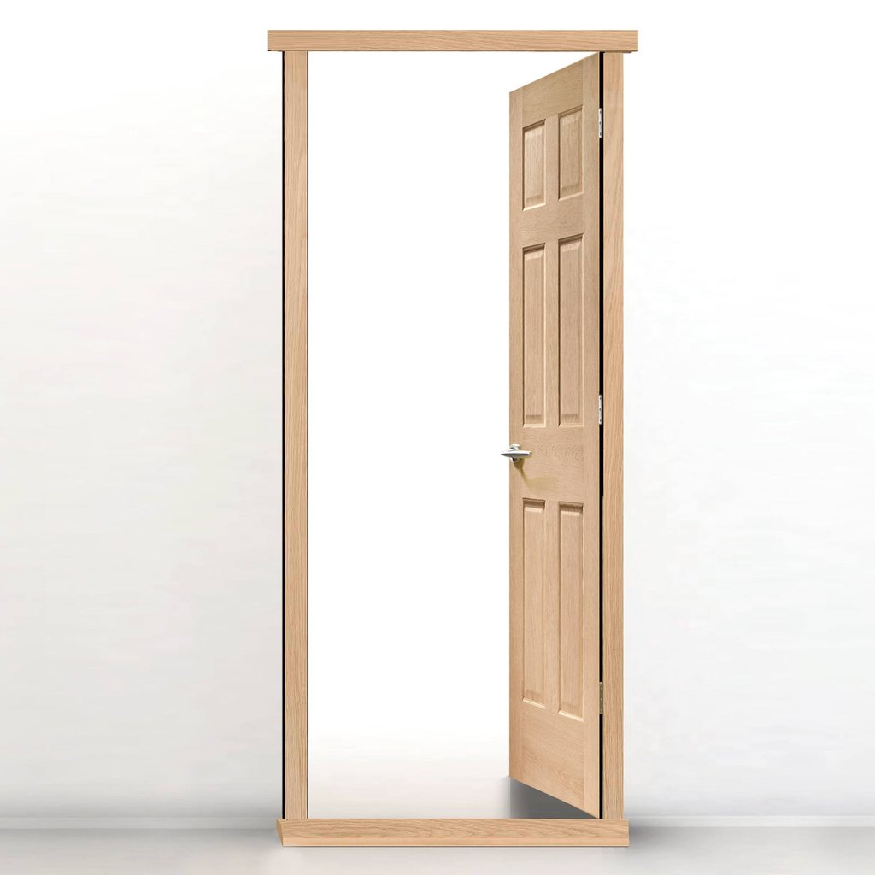
Doorframe ritual
As 1-person corporations we must all …
ADD SIGNIFICANT VALUE
Why do I have this ritual?

Slide 6
What do you DO …
When you are at your best?
Adding the most value?

Slide 7
do vs. DO
Project manager → I help turn creative leaders’ ideas into reality
Master scheduler → I handle the details nobody else wants to
Data warehouse manager → I reveal the answers your data is hiding
Marine Corp document technician → I turn chaos into order
Clothing store owner → I help women feel good about how they look
Assistant town manager → I am an organizational mechanic
Impact on receiver?
Impact on sender?

Slide 8
First-draft DO Statements
Be concise
Make it intriguing
Let it be expansive and freeing rather than limiting
Little or no reference to a job, a company, or even an industry
Stay away from job descriptions
Inspiring to you
Turn it into action as much as possible

Slide 9
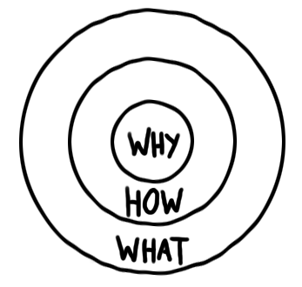
The Golden Circle
Another way to convey how you add value
See Simon Sinek’s TED Talk

Slide 10
Leader’s Edge Consulting – Golden Circle
WHY? I get a kick out of helping people get on with what they’re good at and excited about (Noble Selfishness)
HOW? Customize, explore w/ ‘fresh eyes,’ ask questions, push for action
WHAT? Facilitative-training, facilitating, personal coaching, training

Slide 11
So what!?!
Chinese proverb: After enlightenment comes the laundry.
What is 1 thing you will do as a result of this presentation?
Employees/managers might not do it
Presidents will

Slide 12
Assess & Address
I can find out a heckuva lot quickly by asking four 2-word questions
The matrix you receive in this workshop can be used individually or collectively as a group
Individuals’ examples: My career, my working relationships, my living arrangements, etc.
Groups’ examples: Our group cohesion, our organizational structure, our regular staff meetings, etc.
Start by working through the top-row assessment
For worthy top-row items, go straight down to produce ideas on addressing
This exercise is especially powerful when participants are communicating in “Rich Light” and have the mindset of “Confident Humility”

Slide 13
4: Assess & Address
What’s right? | What’s wrong? | What’s missing? | What’s confusing?
Ideas for boosting | Ideas for fixing | Ideas for inserting | Ideas for clarifying

Slide 14
A&A exercise
Part 1: Each individual spend a few minutes A&A a topic important to you
Circle the bottom-row idea most worth pursuing
Part 2: If you are in the room with other folks from your organization, pick a topic and quickly go through the matrix
Circle the bottom-low idea most worth pursuing
If you are the only person from your organization, do Part 2 by yourself

Slide 15
Final quotations
“The pursuit of excellence is gratifying and healthy. The pursuit of perfection is frustrating, neurotic and a terrible waste of time.” - Edwin Bliss, broadcast journalist, writer, and educator
“Great minds discuss ideas; average minds discuss events; small minds discuss people.” – Eleanor Roosevelt

Slide 16
Powerful equation
Confident Humility (IO) +
President’s Mindset (IO) +
Quadrant 2 (IO) +
Rich Light (RT) +
Assess/Address (RT) =
Success & Satisfaction (Noble Selfishness)

