Slide 1
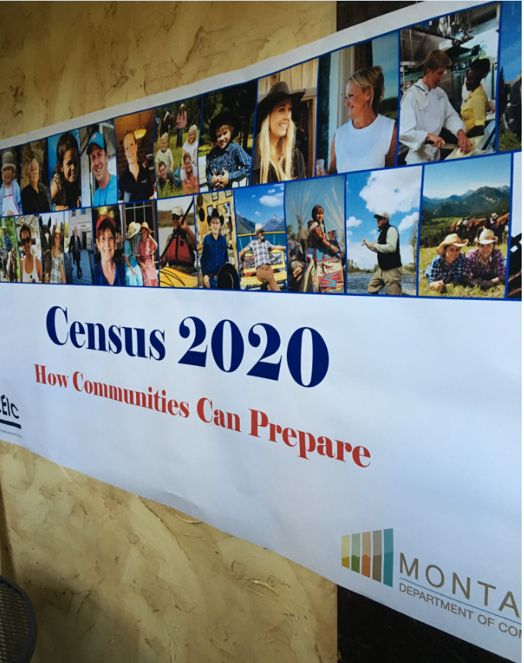
2020 Census: What You Need to Know and Do Now
Stephanie Freeman
307.640.8975
Stephanie.Freeman@2020census.gov
U.S. Census Bureau-Denver Region

Slide 2
Census Overview
Why we do a census:
Article 1, Section 2 of the U.S. Constitution
The actual Enumeration shall be made within three Years after the first Meeting of the Congress of the United States, and within every subsequent Term of ten Years, in such Manner as they shall by Law direct.

Slide 3
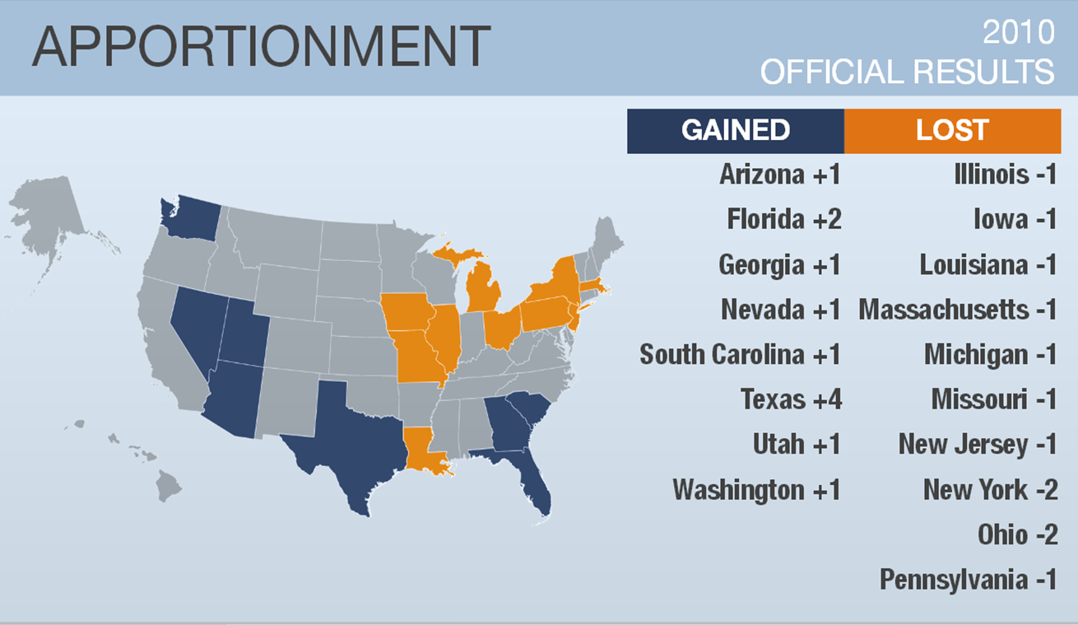
Notes:
This map highlights the Congressional changes that occurred after the last Census.

Slide 4
FUNDING
Wyoming receives over $800 million dollars per year based on Decennial Census data.
$ 881,376,094
$1,504 per person
Notes:
Census data also affect how hundreds of billions of dollars in federal funds are distributed to tribal, state and local governments each year. By 2020, the exact figure will be around $650 billion dollars to the States each and every year, for the next decade.

Slide 5
Key Data Collection Dates
Nov – 2019
April 2018
January-Feb 2019
Aug – Oct 2019
Jan-Aug-2019
Early 2020
March 23, 2020
April 1, 2020
May 2020
August 2020
December 31, 2020
In-Office Address Canvass55
Regional Census Center Opens
Early Area Census Offices Open *
Address Canvassing – select areas
Area Census Offices Open -Casper
Group Quarters Start
Self Response Starts
CENSUS DAY
Non-Response Follow-Up Starts
Data Collection Complete
Counts Delivered to President
Notes:
Now -2019 – Between now and 2019, Census Partnership will work with local governments all over the country to establish Complete Count Committees. In addition, in office address canvassing is happening in our Jeffersonville, Indiana processing center, where staff is determining the areas of high growth and revitalization. With the use of technology, we anticipate sending census listers to only 30% of the country, saving enormous resources from previous censuses where we canvassed every road in the country.
May 2018 – We will open the Regional Census Center in Dallas, TX which will conduct the census operations in our 12 State region.
Jan. – Aug. 2019 – We will open 6 Early Area Census Offices who will recruit and conduct the Field Canvassing operations and 44 Area Census offices in our 12 State region
March 23, 2020 – the census is finally here and this is the first opportunity to self respond via the internet and fill out your census form!
April 1, 2020 is Census Day
May 2020 – Non-response Follow-Up Operations
August 2020 – the Census is over, the Census is over
December 31, 2020 – counts delivered to the President

Slide 6
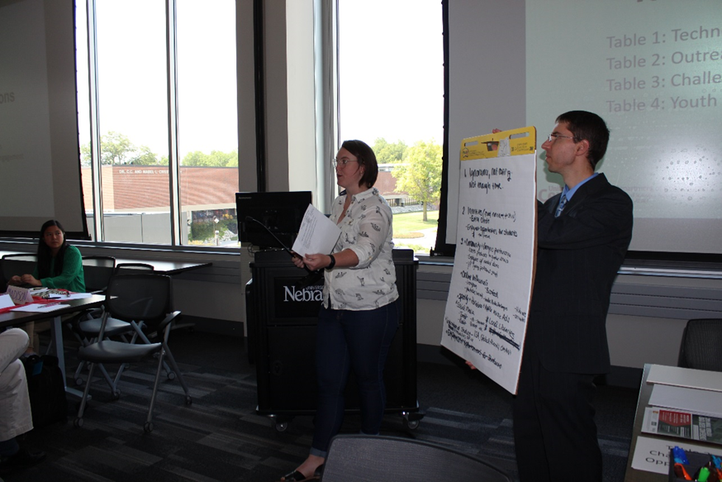
Goals and Challenges
Motivate People to Respond
Assure Respondents that their Data are Confidential and Secure
Educate about Importance
Support communities in their mobilization efforts
Notes:
Moving onto our second innovation area is OPTIMIZING SELF-RESPONSE.
In other words, how do we engage and motivate the public to respond?
The goal of optimizing self-response is to: generate the largest possible self-response, thereby reducing the number of households requiring follow-up.
As I mentioned before, response rates to surveys and censuses have been declining.
To Motivate People to Respond
2020 Census will include a nation-wide communications and partnership campaign.
This campaign is focused on getting people to respond on their own (self-respond) as it costs significantly less to process a response provided via the Internet or through a paper form than it does to send a fieldworker to someone’s home to collect their response.
Advertising will make heavy use of digital media, tailoring the message to the audience.
Learning from and building upon our 2010 Census experiences
We will maximize outreach using traditional and new media to connect with people.
We will target ads to specific audiences and work with trusted voices to inspire participation.

Slide 8
Notes:
As stated, we have begun the process of reaching out to cities, to establish Complete Count Committees (CCCs). We know that despite our best efforts – a national marketing campaign and local efforts to impart the importance of the census, many residents still won’t complete their census questionnaire on their own. This is particularly true in low response areas that have high poverty, large numbers of renters, single family households, young children, immigrants and language barriers. These communities often rely on “Trusted Voices” to assure them that the census is safe, important and reliable.
So we often call on local governments to pull together leaders from different facets of the community: business, education, non-profit, media, faith-based, veterans and immigrant organizations to serve as that trusted voice.

Slide 9
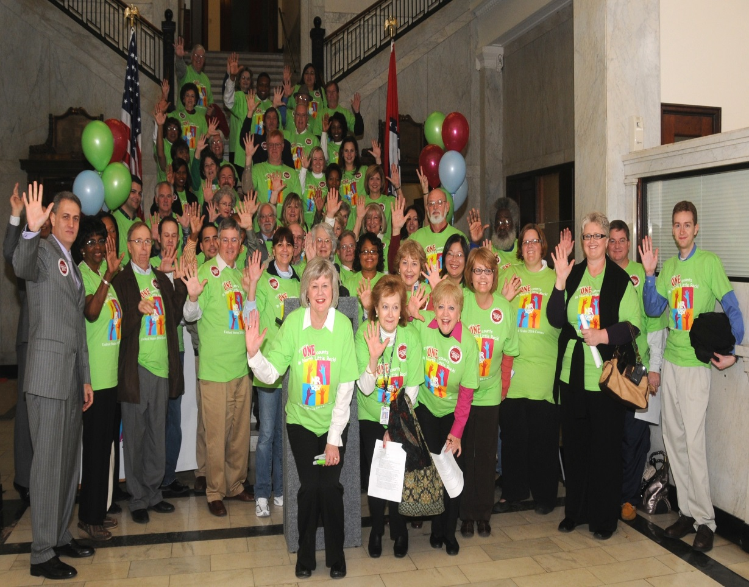
Complete Count Committee Formation
MEDIA
COMM
BUSINESS
FAITH
BASED
EDUCATION
(K-12)
HOMELESS
VETERANS
GROUP
QUARTERS
EX-OFFENDER
RECRUITING
IMMIGRANT
COMMUNITY
ORG
MAYOR
COUNTY
CHAIR
Notes:
As stated, we have begun the process of reaching out to cities, like Irving, to establish Complete Count Committees (CCCs). We know that despite our best efforts – a national marketing campaign and local efforts to impart the importance of the census, many residents still won’t complete their census questionnaire on their own. This is particularly true in low response areas that have high poverty, large numbers of renters, single family households, young children, immigrants and language barriers. These communities often rely on “Trusted Voices” to assure them that the census is safe, important and reliable.
So we often call on local governments to pull together leaders from different facets of the community: business, education, non-profit, media, faith-based, veterans and immigrant organizations to serve as that trusted voice.

Slide 10
Chapter 4: Timeline Key Communications Phases
The 2020 Census Phases
Education Phase – 2018-2019
Awareness Phase – April 2019
Motivation Phase – March – May 2020
Reminder Phase – May – July 2020
Thank You Phase – Starts July 2020
Local governments and community leaders throughout the nation participate in activities highlighting the message that the 2020 Census is imminent and that it is easy, important and safe to participate
Notes:
Next, we’re going to quickly go over the Census timeline and key communication phases. We want all CCC’s to be working in conjunction with our key operational phases – so that the entire country and all of our CCCs speak with one voice – even if our messaging to different communities will be unique.
The 2020 Census Phases include an:
Education Phase – 2018-2019
Awareness Phase – April 2019
Motivation Phase – March – May 2020
Reminder Phase – May – July 2020
Thank You Phase – Starts July 2020

Slide 11
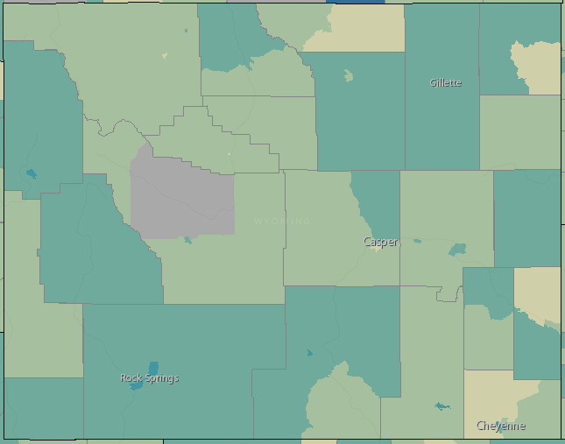
Response Outreach Area Mapper (ROAM)
census.gov/roam
Notes:
Once formed, the CCC will begin drafting a plan based on the specific challenges within high low response areas of Wyoming.
To assist with this task, the Census developed an interactive web mapping application called the Response Outreach Area Mapper (ROAM) that allows users to access data available in the Census Bureau’s Planning Database to plan outreach, marketing and promotional efforts. With ROAM, the darkest color-shaded colors indicate the highest low response areas with a percentage of those least likely to respond to a census questionnaire.

Slide 12
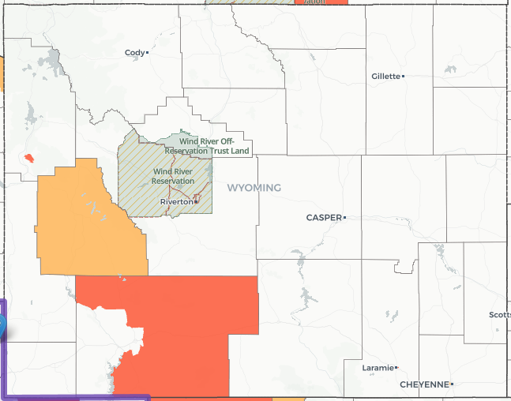
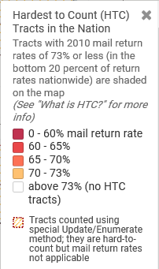
Hard to Count 2020
https://www.censushardtocountmaps2020.us/
Notes:
Let’s take a look at some of the variables that make this tract harder to count and discuss how we can overcome these barriers.
Look at the LRS (Low Response Score--predicted level of Census self nonresponse at the tract level ) As you can see I have Tract 4 information's listed on this slide. It has an LRS of 23.7 meaning we are estimating that 23.7% of households in that tract will NOT self-respond to the Census
2. Look at Race
Poverty level – what does that mean? Means people may be so focused on making ends meat that they simply don’t have time to worry about a census questionnaire. What are things we can do to address that?
Work through health and human services/social service organizations to develop messages about how filling out the Census questionnaire helps keep funding for programs – food assistance, housing assistance, day care assistance, transportation, work force development, etc.
Level of education – Effective Census in School programs should be developed
Renter occupied housing units – working through the apartment association, apt. managers to provide census kiosks in the leasing building – or placing messages on apt. doors to please self-respond online or by phone – offering discounts on rent for those who do – the goal to avoid NRFU and disruption to the apt. complex.

Slide 13
Hard to Count 2020
In 2010, 79.9% of households returned their census forms
Remaining 20.1% received in-person enumeration
Hard to Count areas include those with relatively poor internet access
16.3% of Wyoming households have either no internet access or dial-up only
Center for Urban Research states that close to 100% of the US Population lives within 5 miles of at least 1 library.
https://www.gc.cuny.edu/
Notes:
Let’s take a look at some of the variables that make this tract harder to count and discuss how we can overcome these barriers.
Look at the LRS (Low Response Score--predicted level of Census self nonresponse at the tract level ) As you can see I have Tract 4 information's listed on this slide. It has an LRS of 23.7 meaning we are estimating that 23.7% of households in that tract will NOT self-respond to the Census
2. Look at Race
Poverty level – what does that mean? Means people may be so focused on making ends meat that they simply don’t have time to worry about a census questionnaire. What are things we can do to address that?
Work through health and human services/social service organizations to develop messages about how filling out the Census questionnaire helps keep funding for programs – food assistance, housing assistance, day care assistance, transportation, work force development, etc.
Level of education – Effective Census in School programs should be developed
Renter occupied housing units – working through the apartment association, apt. managers to provide census kiosks in the leasing building – or placing messages on apt. doors to please self-respond online or by phone – offering discounts on rent for those who do – the goal to avoid NRFU and disruption to the apt. complex.

Slide 14
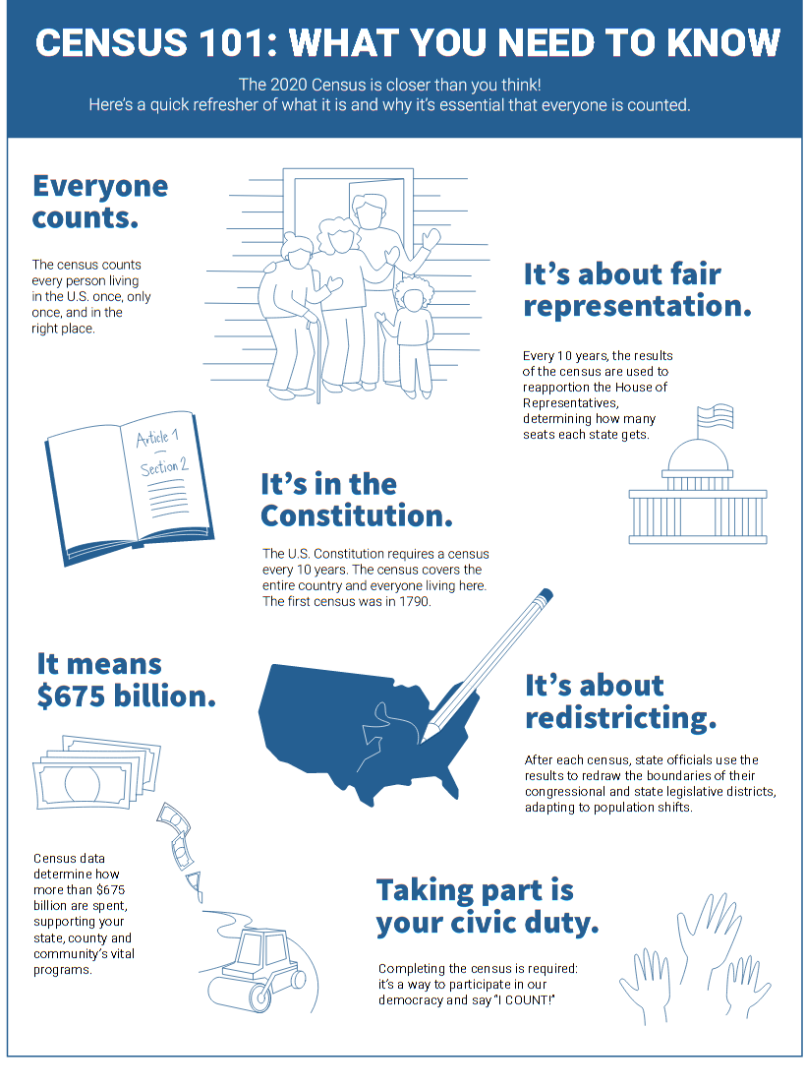
CCC TOOLS
https://www.census.gov/programs-surveys/sis.html
https://www.census.gov/partners/toolkit.pdf

Slide 15
CENSUS JOBS NOW LIVE!
www.2020census.gov/jobs

